Slide 1
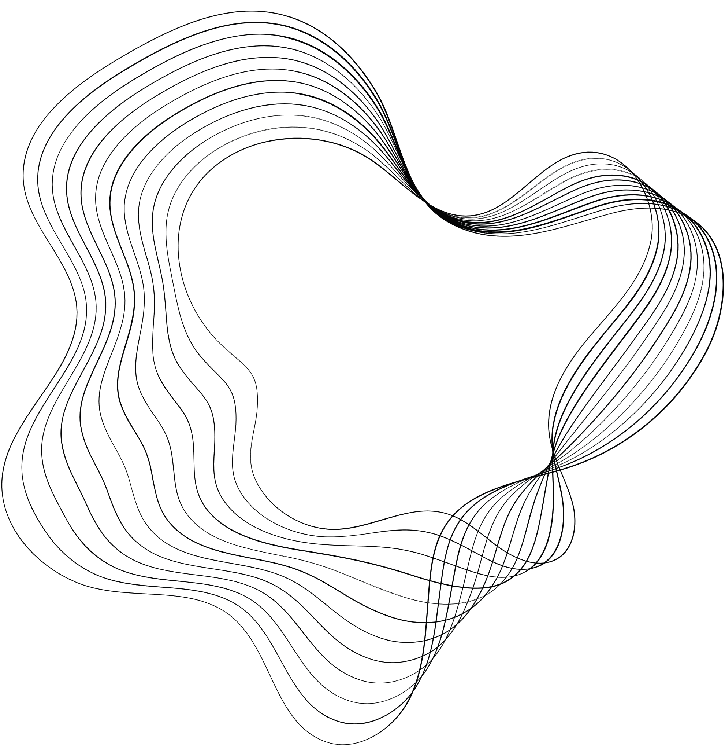

AIR-PLAY
A Gesture Controller that turns your movements into commands
Under the guidance of Dr. V. Uma
NAME : SOUBHAGYA PRUSTY
REG NO : 22352065

Slide 2

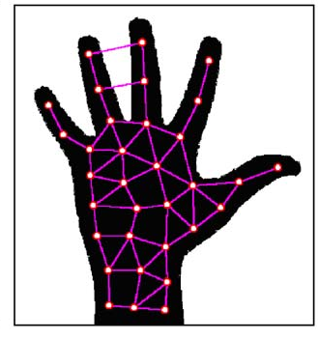


GESTURE CONTROLLER
Python based application
Uses Computer Vision technologies
Uses Image Recognition techniques
Detect hand & head gestures
Performs action based on gestures

Slide 3


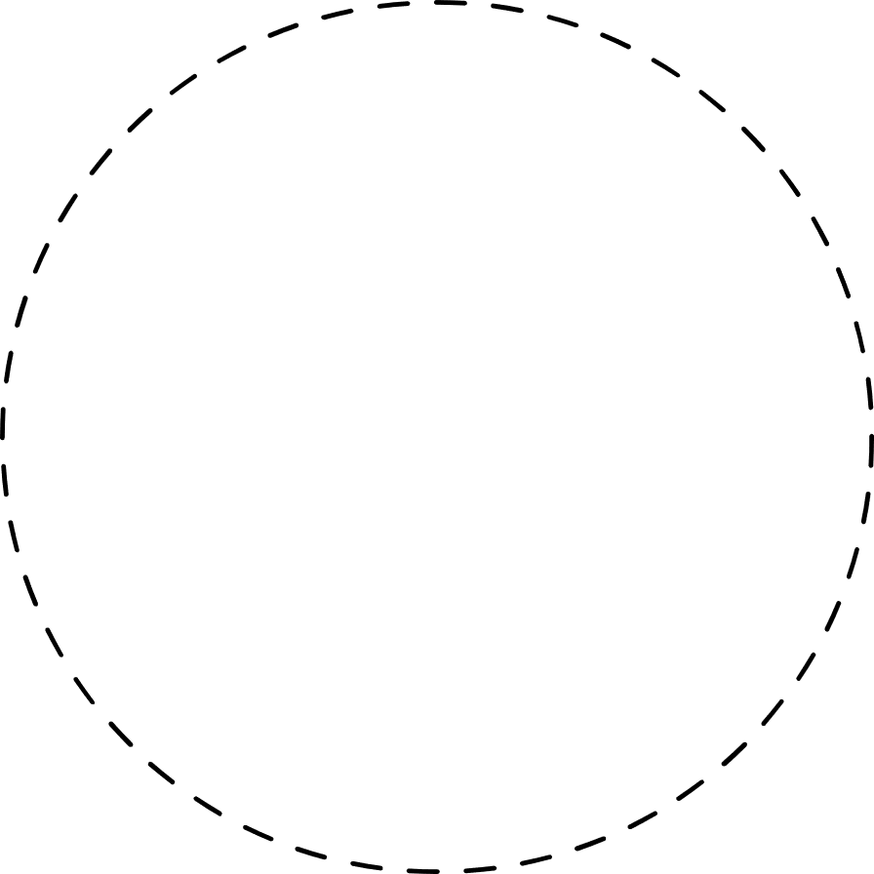


HARDWARE REQUIREMENTS
CAMERA
COMPUTER
A webcam or any compatible camera for capturing real-time video input.
A computer with sufficient processing power to handle real-time video processing and game logic.

Slide 4
SOFTWARE REQUIREMENTS
PROGRAMMING LANGUAGE
Python
LIBRARIES
OpenCv , Mediapipe, CVZone , Tkinter, Pyautogui
GAME ENGINE
Pygame
OTHER REQUIREMENTS
Proper background light

Slide 5
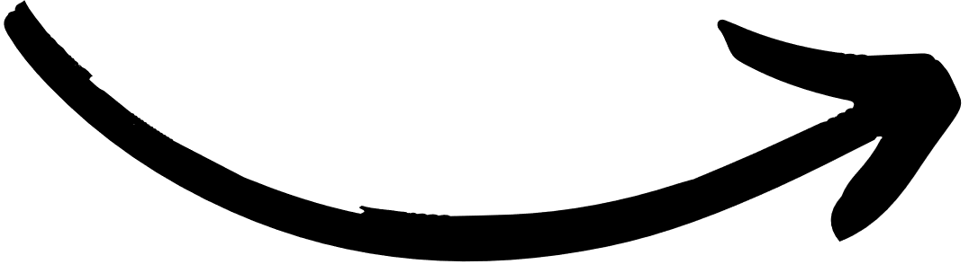
WORKING PROCESS
Start the webcam or other camera linked with the device
Recognize gestures using mediapipe , cvzone
Track the hand or head using opencv
Control the mouse and keyboard using pyautogui
CAMERA INITIALIZATION
RECOGNITION
TRACKING
CONTROL

Slide 6

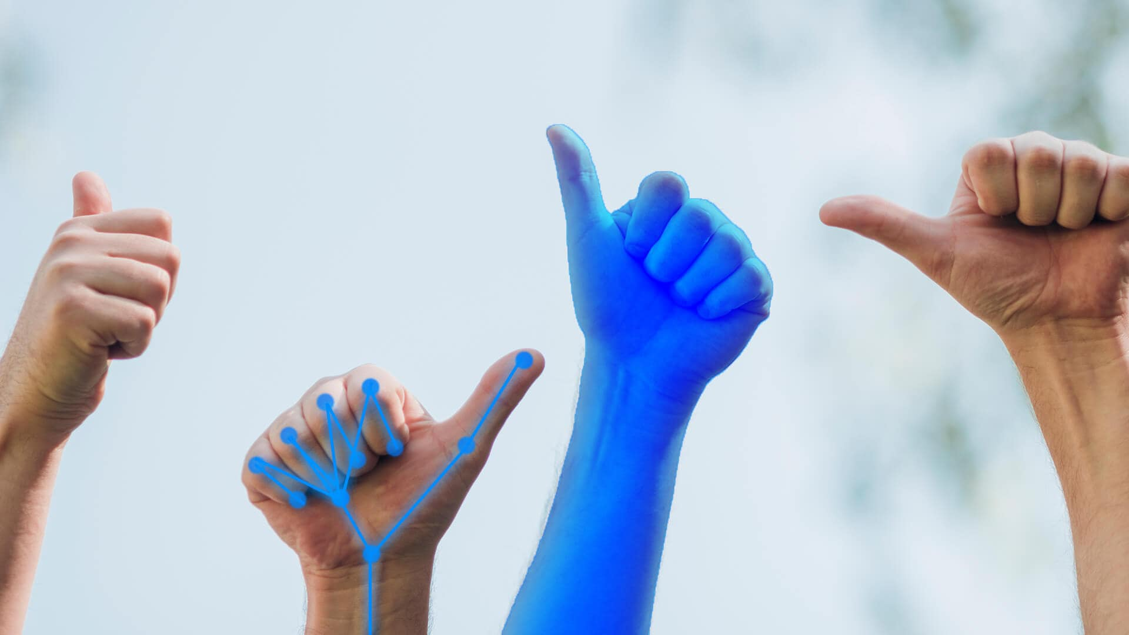
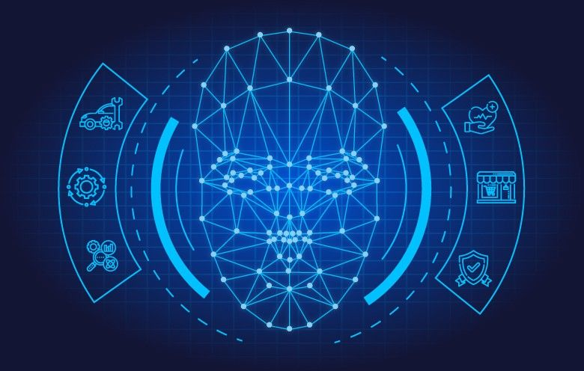
USE-CASES
Handicapped people
Useful for handicapped people.
Different hand & head gestures for different handicap people
AR / VR
Can be integrated with AR / VR
Cheap & Affordable competitor for AR/VR

Slide 7
USE-CASES
Smart Devices
Smart Devices can be made.
Instruct devices to perform task through gestures.
No Physical Interaction
No physical interaction needed with physical devices.
Can be used at a recognizable distance.

Slide 8
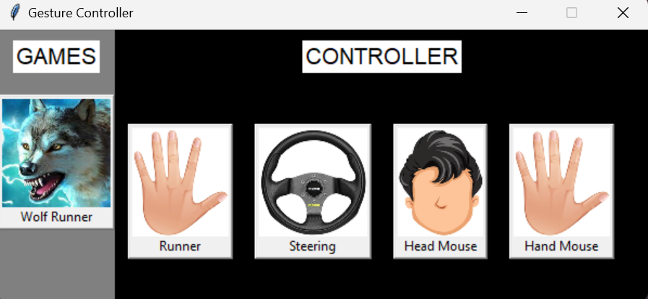
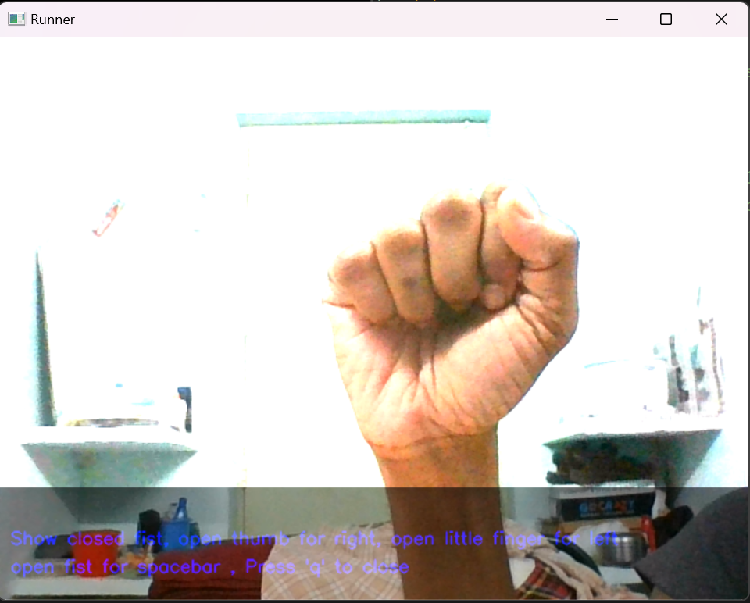
APPLICATION
HOME PAGE
AROW KEY CONTROLLER

Slide 9
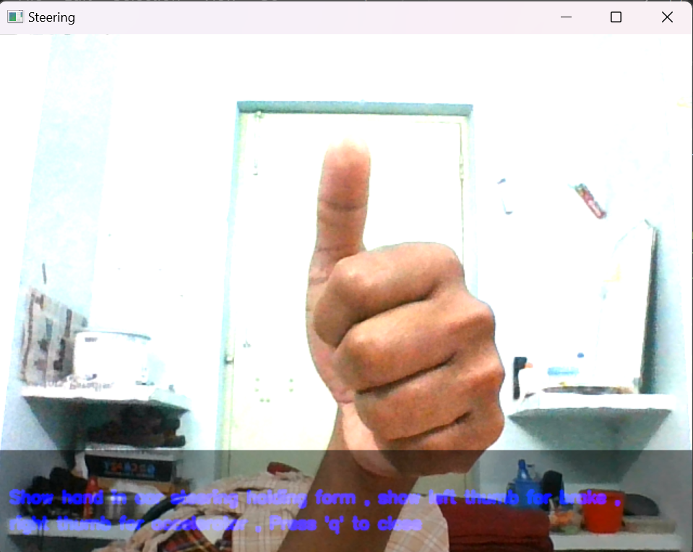
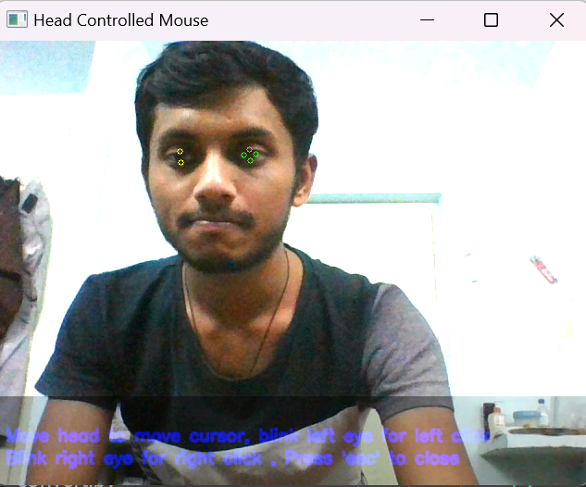
APPLICATION
STEERING
HEAD MOUSE CONTROLLER

Slide 10
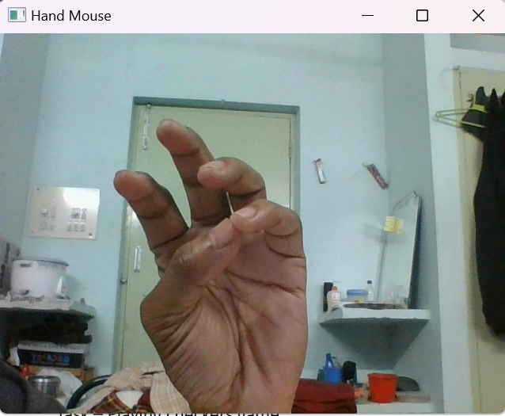
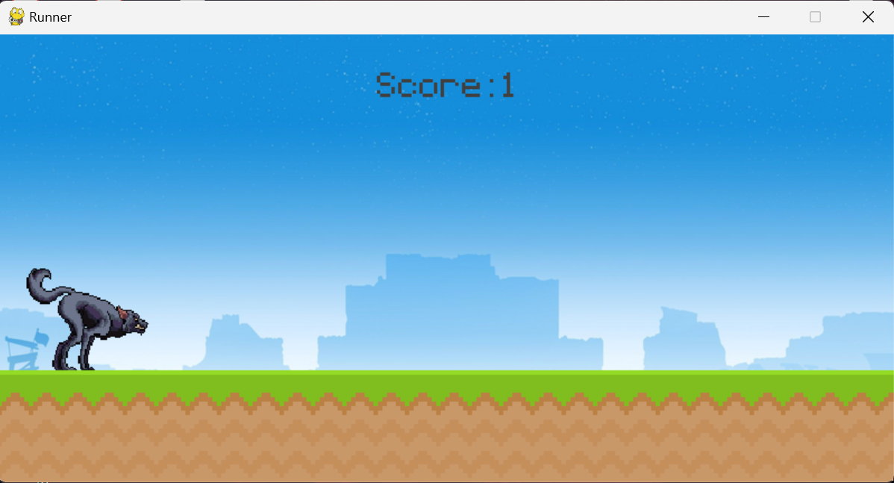
APPLICATION
HAND MOUSE CONTROLLER
GESTURE CONTROLLED GAME

Slide 11
THANK YOU

